Slide 1
User Group Meeting
Electronic Subdivisions Unit
spear.info@delwp.vic.gov.au
15 July 2021

Slide 2
Agenda
Welcome
Introduction, Melissa Harris - Chief Executive, Land Use Victoria
SPEAR IT
Release 5.3 overview
Release 5.4 overview
Future enhancements
ePlan Update
ePlan Creation Service and Portal
Pilot program and Single CAD Format File (SCFF)
Short Break

Slide 3
Agenda
Service Desk update
Signing Application
Handy hints
LASSI
A2A support
Training and support update
Other matters
Subdivision (Registrars Requirements) Regulations 2011
Owners Corporation Additional Information​
Questions and wrap up

Slide 4
Chief Executive
Land Use Victoria
Melissa Harris
15 July 2021

Slide 5




Growth of SPEAR
220+ surveying firms
All 79 Victorian councils signed up
53 referral authorities​
570+ SPEAR ELN organisations
More than 4,000 SPEAR users​
20,000+ guests

Slide 6




Working together to maximise electronic data processing
Plan applications submitted in SPEAR by surveying firms
Minimal electronical processing opportunity
[100%]
1
SPEAR
Plan applications lodged electronically by legal & conveyancing firms
Data integration with plan registration
2
[65%]
3
ePlan application submitted in SPEAR by surveying firms
Data integration with digital cadastre
4
ePlan application lodged electronically by legal & conveyancing firms
Data integration with plan registration & digital cadastre

Slide 7
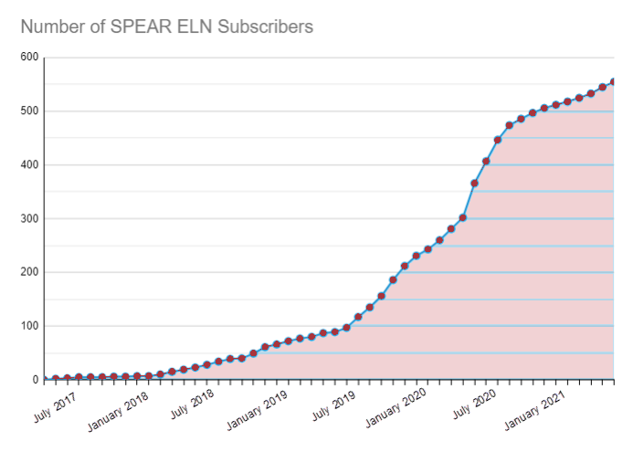
SPEAR Electronic Lodgment Network (ELN)
SPEAR ELN Subscriber activity
Electronic Lodgments
Year | Lodgments | %
2018 | 454 | 4.68
2019 | 1751 | 17.83
2020 | 5281 | 55.41
2021 | 2320 | 65.42

Slide 8



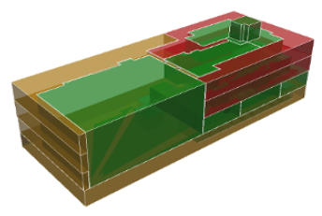



Land Use Victoria (LUV) Digital Cadastre Initiatives
SPEAR facilitating digital data exchange across varied stakeholder groups
ePlan Portal integrated in SPEAR
LUV Working towards:
“A cadastral system that enables people to readily and confidently identify the location and extent of all rights, restrictions and responsibilities related to land and real property.”
ICSM Vision for
Cadastre 2034
2D ePlan
Single CAD Format File (SCFF)
2D Digital Cadastre Modernisation project
Vicmap modernisation
Plan automation updates
Cadastral data distribution service
3D cadastral data model and transfer standards
3D ePlan
3D digital cadastre
Digital Twin Victoria
eComply

Slide 9
SPEAR IT Update
User Group Meeting
15 July 2021

Slide 10
Release 5.3 overview: Launched 5 July 2021
The following changes were introduced to SPEAR:
Allow receiving and relinquishing parties to be represented by different lodging parties
Lodging party usability enhancements
Extending the ‘Nominated Licensed Surveyor’ information
Renaming 207D Applications
Locking the Organisation name and ABN from being modified by local administrators
FIX: Public Search link redirecting users to a login page

Slide 11
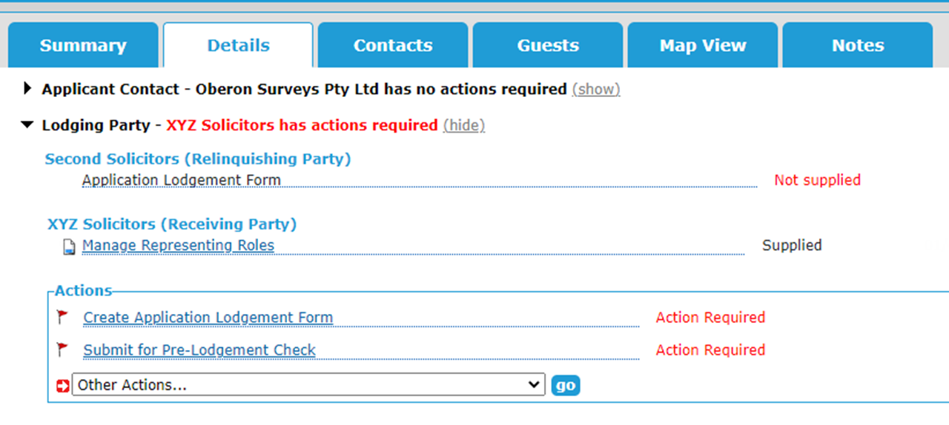
Allow receiving and relinquishing parties to be represented by different lodging parties
Two different lodging parties can now operate in a single SPEAR application on behalf of the receiving and relinquishing parties
This applies only to applications to create an easement under Section 45 of the Transfer of Land Act 1958

Slide 12
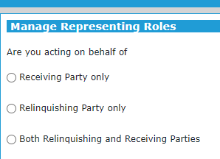
Allow receiving and relinquishing parties to be represented by
different lodging parties
The primary lodging party is nominated by the surveyor and is required to ‘Manage Representing Roles’ in SPEAR. They will select their role as either:

Slide 13
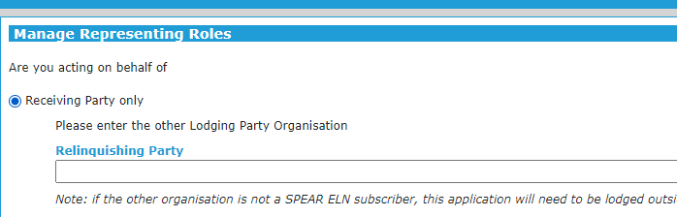
Allow receiving and relinquishing parties to be represented by
different lodging parties
The user will be required to invite the other lodging party into the application to act in the other role
Note: If the other organisation is not a SPEAR ELN subscriber, this application will need to be lodged outside of SPEAR
Second Solicitors

Slide 14
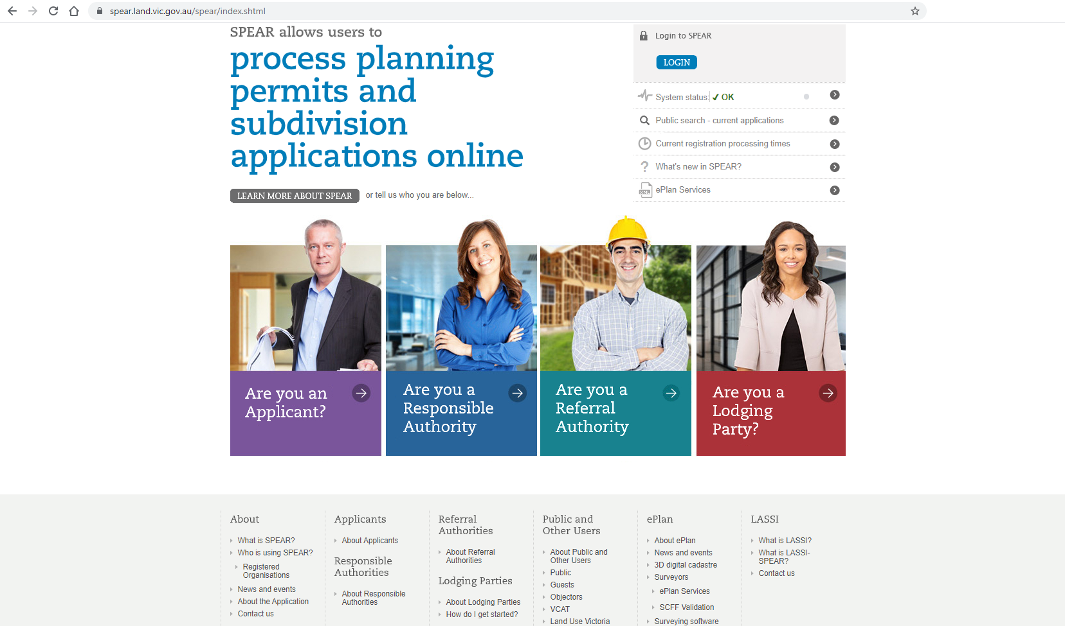
Allow receiving and relinquishing parties to be represented by
different lodging parties
To see who is using SPEAR, click on the Registered Organisations link from the SPEAR home page and enter the organisation name

Slide 15
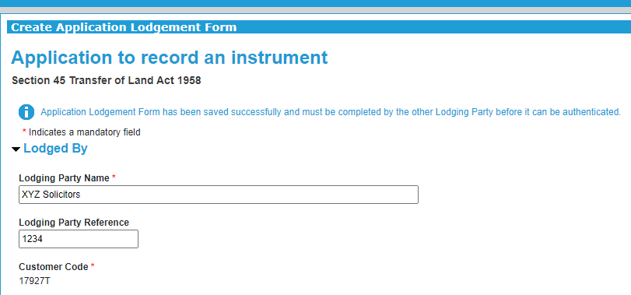

Allow receiving and relinquishing parties to be represented by
different lodging parties
Both lodging parties will be required to complete/edit and sign their section of the Application Lodgement Form
Application Lodgement Form has been saved successfully and must be completed by the other lodging party before it can be authenticated

Slide 16
Allow receiving and relinquishing parties to be represented by
different lodging parties
Interactions with Land Use Victoria (LUV)
Once the Form has been signed by both lodging parties, the primary lodging party is responsible for:
 Payment
 Lodgment
 Responding to LUV requisitions
 Withdrawing / re-opening the application
Notes:
<read slide>
That brings us to the end of the first and largest change in this release. If you have any questions about this functionality, please put them into the comments box in Microsoft Teams or feel free to email us – spear.info@delwp.vic.gov.au

Slide 17
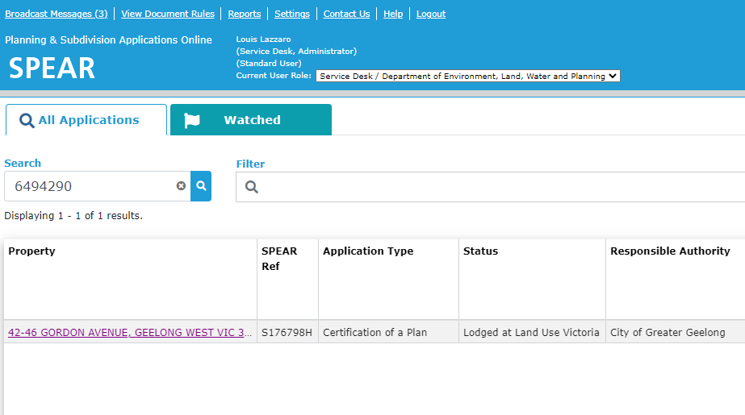
Lodging party usability enhancements
Allow a lodging party to search for a SPEAR application using the lodgment number

Slide 18
Lodging party usability enhancements
Allow a lodging party to create the Application Lodgement Form(s) once the application is submitted to the Responsible Authority
Only allow special characters (from the standard English keyboard) on the Application Lodgement Forms, such as: ~`!@#$%^&*()_-+={[}]|\:;”’<,>.?/
Easier for logged in users to request lodging party access from the Public Search screen by pre-populating the SPEAR Reference number in the Request Lodging Party Access screen

Slide 19
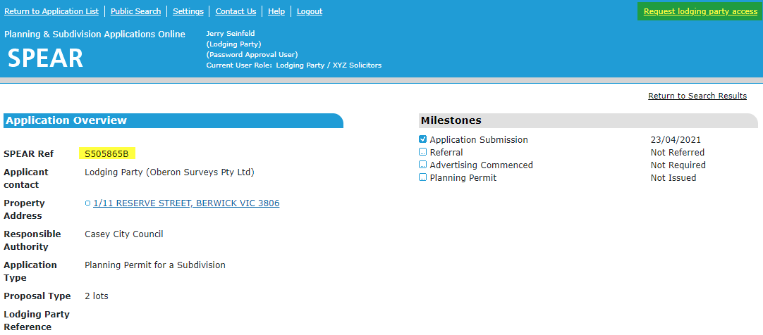
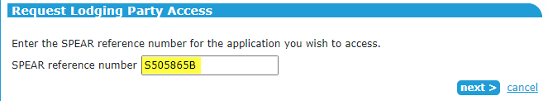
Lodging party usability enhancements

Slide 20
Lodging party usability enhancements
Section 32(f) Subdivision Act dealing type and Section 15 Transfer of Land Act dealing type will no longer require title nomination
Sections 32(d) and 35(8) (PS and PC) Subdivision Act dealing types will undergo a manual check by LUV to confirm title nomination
Additional notifications to LUV when a pre-lodgment check submission is cancelled or is awaiting authentication

Slide 21
Lodging party usability enhancements
Improved error messages when requesting lodging party access, creating an application and saving an Application Lodgement Form. Generic messages such as:
This application is not valid for the lodging party access request. Contact the
SPEAR Service Desk for more information.
Have been replaced with more helpful messages such as:
Unable to request lodging party access as the application is in the wrong status
Unable to request lodging party access as another organisation has already been nominated as the lodging party for this application. Please contact the Applicant Contact
Unable to request lodging party access as you already have access to this application

Slide 22
Extending the ‘Nominated Licensed Surveyor’ information
The Nominated Licensed Surveyor information will be extended to application types other than subdivisions, including:
Boundary plans
Transfer of Land Act
Local Government Act applications
Applications submitted to Surveyor-General Victoria

Slide 23
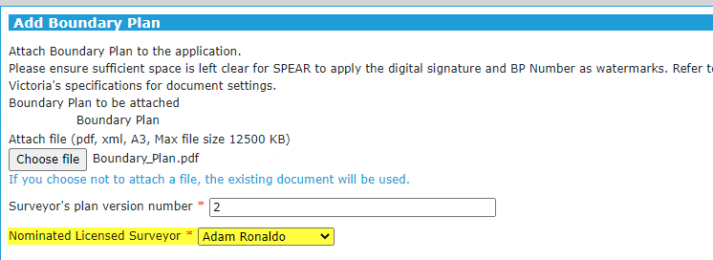
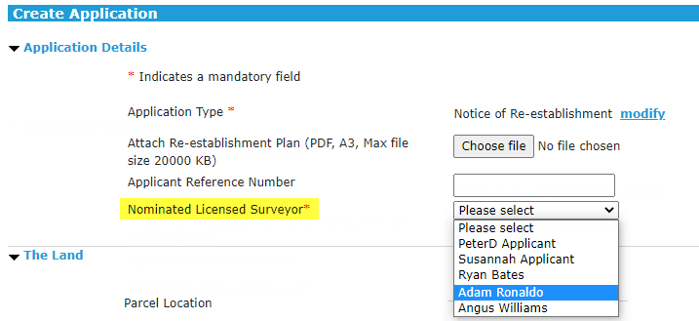
Extending the ‘Nominated Licensed Surveyor’ information
For most applications the Applicant Contact will be required to specify the Nominated Licensed Surveyor when uploading a plan
For applications submitted to Surveyor-General Victoria, the Nominated Licensed Surveyor is set when creating the application

Slide 24
Renaming 207D applications
Dealing type description for Section 207D – Transfer of Closed Road applications will now be shown as Section 207D – Notice
The residual lodgment form will be renamed ‘Application to Request Action by the Registrar’
The ‘Grounds of Application’ can be defined on the form with the following options displayed on screen:
      The Land vests in Council under section 207B of the Local Government Act 1989
      The Applicant has taken action under clause 2, 3, 7 or 8(1)(a) of Schedule 10 or clause 11 of Schedule 11 of the Local Government Act 1989

Slide 25
Organisation name and ABN locked from editing by
local administrators
Organisation Name and ABN as shown on the SPEAR organisation profiles are now only modifiable by SPEAR Administrators
Local Administrators will see the field however, it will be greyed out and locked for editing
NOTE: Local Administrators needing to change their organisation name or ABN should contact the SPEAR Service Desk for assistance
Depending on the change, a new SPEAR agreement may be required

Slide 26
FIX: Public Search link
The Public Search will no longer send the user to the SPEAR Login screen in error. The Public Search screen will be displayed as expected with no need for the user to log on
Notes:
This is an issue which generated a lot of requests for support from public users, and some of your customers, or even you, may have run into this issue – the SPEAR Public Search sometimes asked you to log in, even though it shouldn’t have. This issue has been fixed, so… <read slide>
As always, if anyone is experiencing any issues, the SPEAR Service Desk is here to help. That brings us to the end of the changes introduced in this latest version of SPEAR last week. If you have any further questions about any of this functionality, please put them into the comments box in Microsoft Teams, or feel free to email us – spear.info@delwp.vic.gov.au

Slide 27
Release 5.4 overview
The following changes are scheduled for SPEAR Release 5.4 (October 2021):
Integration of ePlan Portal with SPEAR
Improvements to title checking for applications affected by a Melbourne Strategic Assessment (MSA) notice
Changes to provide users with more time to update to a new version of the SPEAR Signing Application

Slide 28
Integration of ePlan Portal with SPEAR
The ePlan Portal (including ePlan Creation Service) will be made available to all SPEAR users
Surveyors will be able to save their Single CAD Format Files (SCFF) and ePlans created in the Portal to the cloud
Surveyors will be able to retrieve and use their saved ePlans directly within SPEAR
Additional data population when creating ePlans – e.g. surveyors registration number, surveying firm logo etc.
Automatic preservation of metadata between ePlan versions
Other SPEAR users in an application will be able to use the ePlan Portal to view and interrogate the ePlan
24/7 availability of the ePlan Portal

Slide 29
Improvements to title checking for MSA
If the lodging party has completed the Application Lodgement Form before SOC, SPEAR will use the up-to-date vol/fols supplied by the lodging party to determine if an application requires MSA consent from DELWP
Otherwise, if the lodging party provides up-to-date vol/fols on the Application Lodgement Form after SOC, SPEAR will perform a second check at that point to determine whether the application requires MSA consent from DELWP
This change ensures that applications requiring MSA consent are identified as early as possible, once the up-to-date vol/fols are provided in SPEAR

Slide 30
Provide users more time to update SPEAR Signing Application
A new version of the SPEAR Signing Application will be released in October 2021 and users will be asked to update
SPEAR will be changed to allow both the previous version and the new version to work concurrently, providing users with more time to update
The previous version of the Signing Application expires in January 2022, so users must download and install the new version to be able to sign from this date onwards (exact date in January 2022 to be confirmed)
SPEAR previously required all users to update on release day, so this change will provide users and their IT departments more time to roll out updated versions of the SPEAR Signing Application

Slide 31
Future enhancements
Future enhancements (subject to approval) include:
Surveyors to purchase plan numbers in SPEAR
Changes to support the Digital Cadastre Modernisation project
Surveyors to provide Owners Corporation Additional Information
Application List enhancements – new columns, ability to save searches
Allow uploading of site photos in image formats – e.g. .jpg, .png etc.
Support for applications submitted to multiple Responsible Authorities
Align addressing standard across SPEAR
Client list/address book functionality
Allow surveyors to withdraw, amend and re-submit RE applications
Support for VicRoads Survey Plans (SP) in SPEAR

Slide 32
Future enhancements
The Potential Enhancements list, circulated prior to the User Group Meeting, is a prioritised listing of all future SPEAR enhancements (subject to approval)
The list was distributed with the User Group Meeting invite
As always, please let us know if there are any changes you would like to see in SPEAR that aren’t on the list, or are prioritised higher or lower than expected
This allows us to ensure we focus on the most useful enhancements to SPEAR users

Slide 33
Questions?

Slide 34
User Group Meeting
15 July 2021
5 Minute Break

Slide 35
ePlan Update
User Group Meeting
15 July 2021

Slide 36
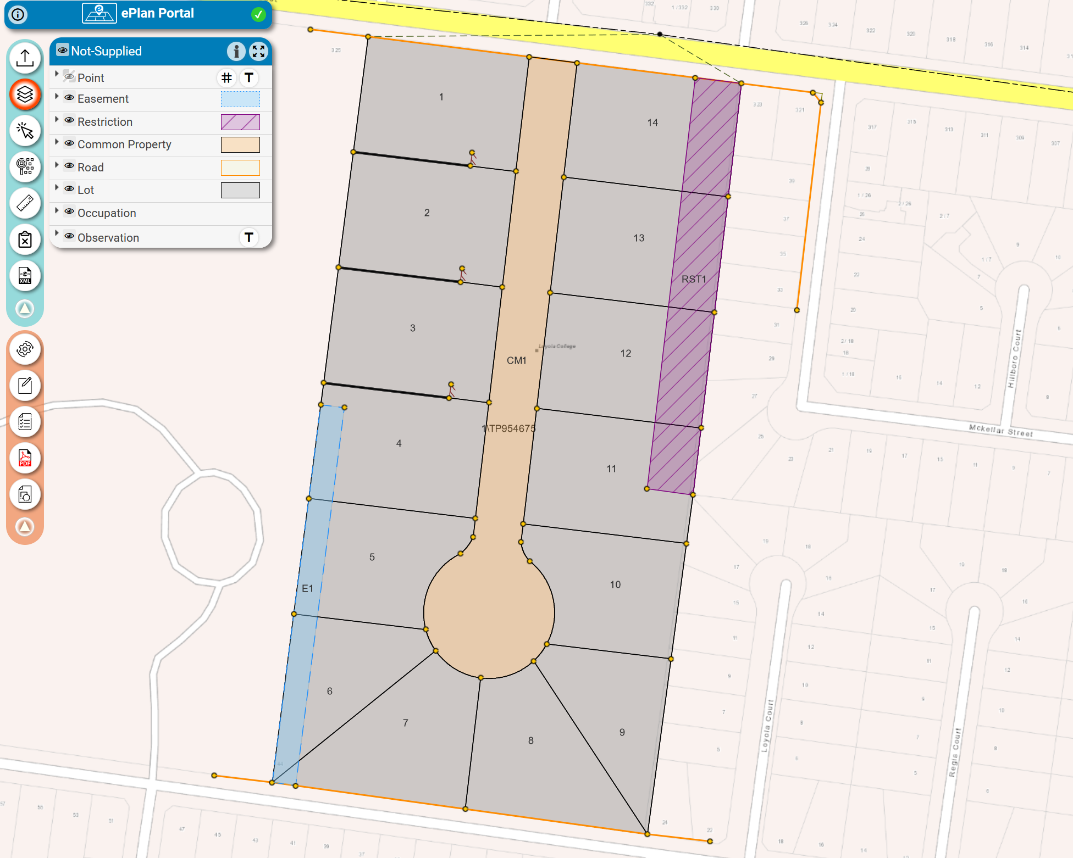
ePlan update
Introduction
Single CAD Format File
ePlan Creation Service Pilot
ePlan portal

Slide 37
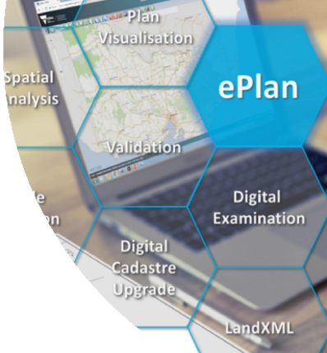
ePlan update - Introduction
New approach to creating ePlans:
Making ePlan accessible to all surveyors
Land subdivisions being the initial focus
Streamlined process that leverages from the Single CAD Format File (SCFF)
Facilitates immediate efficiencies in the updating of Vicmap for PDF plan applications in SPEAR
Work is underway in the Digital Cadastre Modernisation Program to automate the update of the digital cadastre

Slide 38




Single CAD Format File - SCFF
Industry Collaboration and Support
Land Use Victoria (LUV), in collaboration with the surveying industry, has defined an agreed Single CAD Format File (SCFF)
SCFF is not a new file type - The file adopts a standardised layout for the Drawing Exchange Format (DXF) version 2010
SCFF Validation Service and Defined Layers - Released February 2021

Slide 39
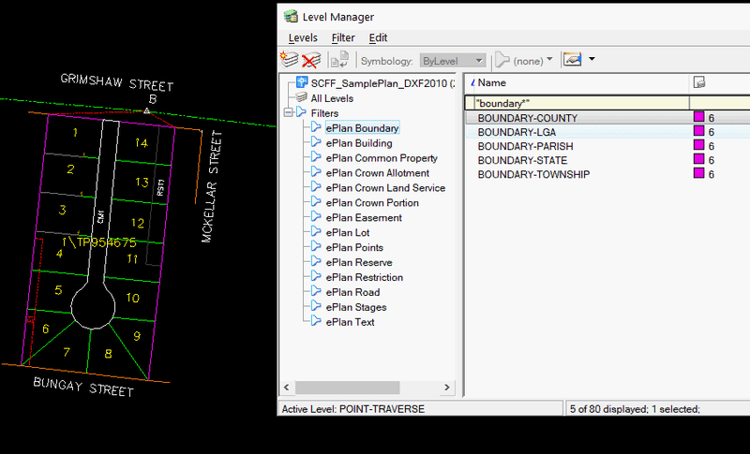
Single CAD Format File - SCFF
SCFF Layers
The SCFF template contains 73 standard layers that can be processed and validated
Templates
.DWT (AutoCAD)
.SEE (LISCAD)
.DGN (MicroStation CONNECT)
    Industry standards and consistency in CAD files that supports all cadastral plans and surveys supplied in SPEAR

Slide 40
Single CAD Format File - SCFF
SCFF Adoption
Previous CAD templates do not need to be discarded to adopt the new SCFF template
New CAD Layering System
SCFF adoption has already begun - several surveyors have produced an SCFF and validated them successfully
Surveyor-General Victoria (SGV) is adopting the SCFF

Slide 41
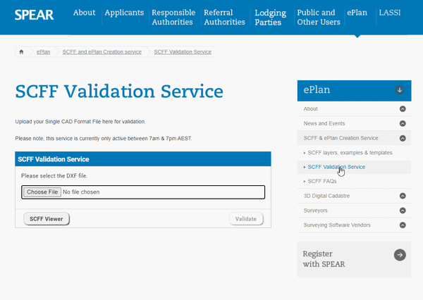
Single CAD Format File - SCFF
SCFF Validation Service
LUV has developed the SCFF Validation Service that
enables users to confirm they have correctly adopted the layers of the SCFF
Single CAD Format File Validity
Geometrical Feature Existence in Standard CAD Layers
Expected Feature Types
Text Labels Required
Naming Conventions
SPEAR Homepage > ePlan > SCFF & ePlan Creation Service > SCFF Validation Service

Slide 42
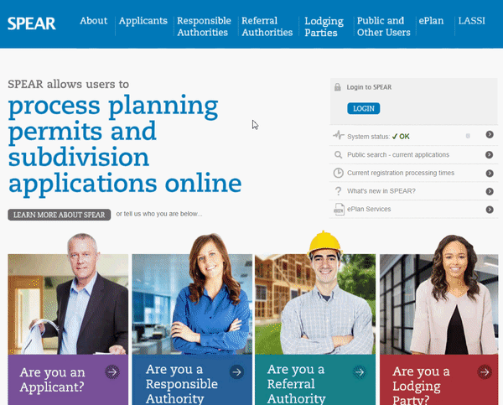

Single CAD Format File - SCFF
SCFF Guidance Notes & Templates
SCFF templates
Guidance notes
List of layers
CAD examples
FAQs
If you would like more information or assistance getting started with the SCFF -
Contact the SPEAR Service Desk.
spear.info@delwp.vic.gov.au
SPEAR Homepage > ePlan > SCFF & ePlan Creation Service > SCFF layers, examples & templates

Slide 43
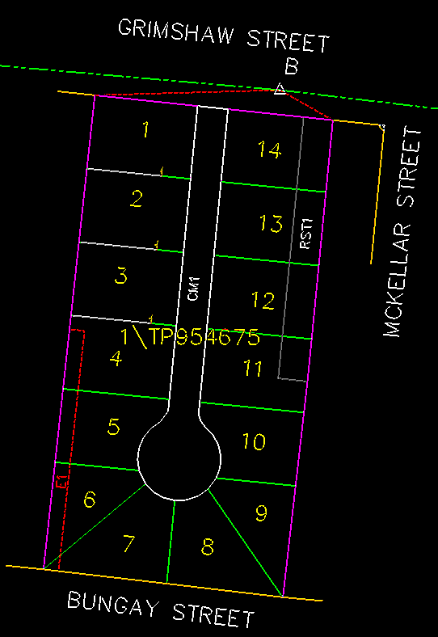
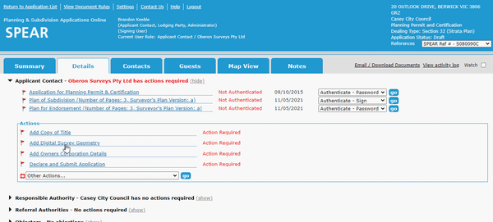

Single CAD Format File - SCFF
1. CAD Input
2. SPEAR – Digital Survey Geometry
Compliant DXF
SPEAR - Subdivision Act

Slide 44
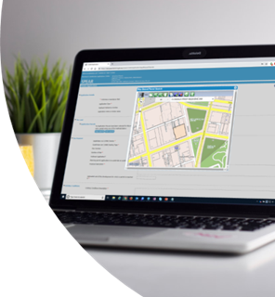










Organisations Participating in Pilot: 10
ePlan Creation Service Pilot
ePlan Creation Service Pilot – 20th July 2021

Slide 45
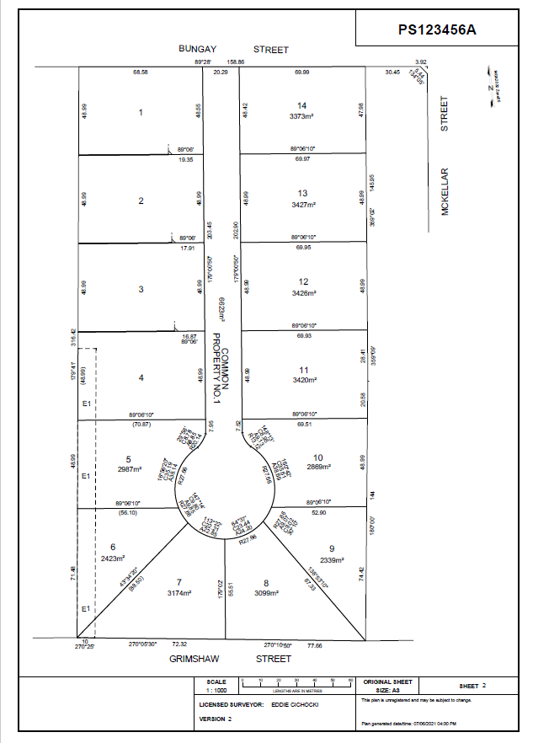
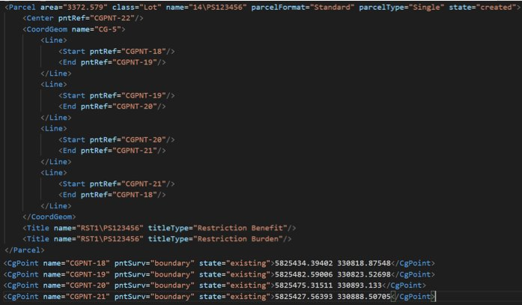
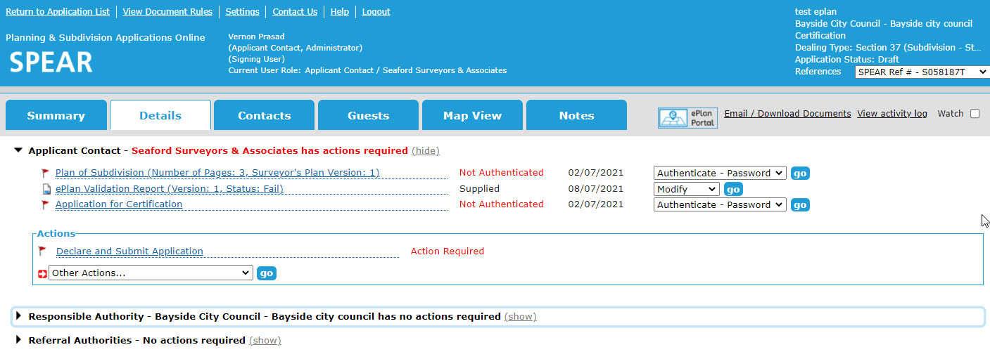
ePlan Creation Service (SCFF to ePlan)
1. CAD Input
2. Data Enumeration
3. Automatically
Generated Outputs
Compliant DXF
ePlan Portal
PDF
SPEAR
LandXML

Slide 46
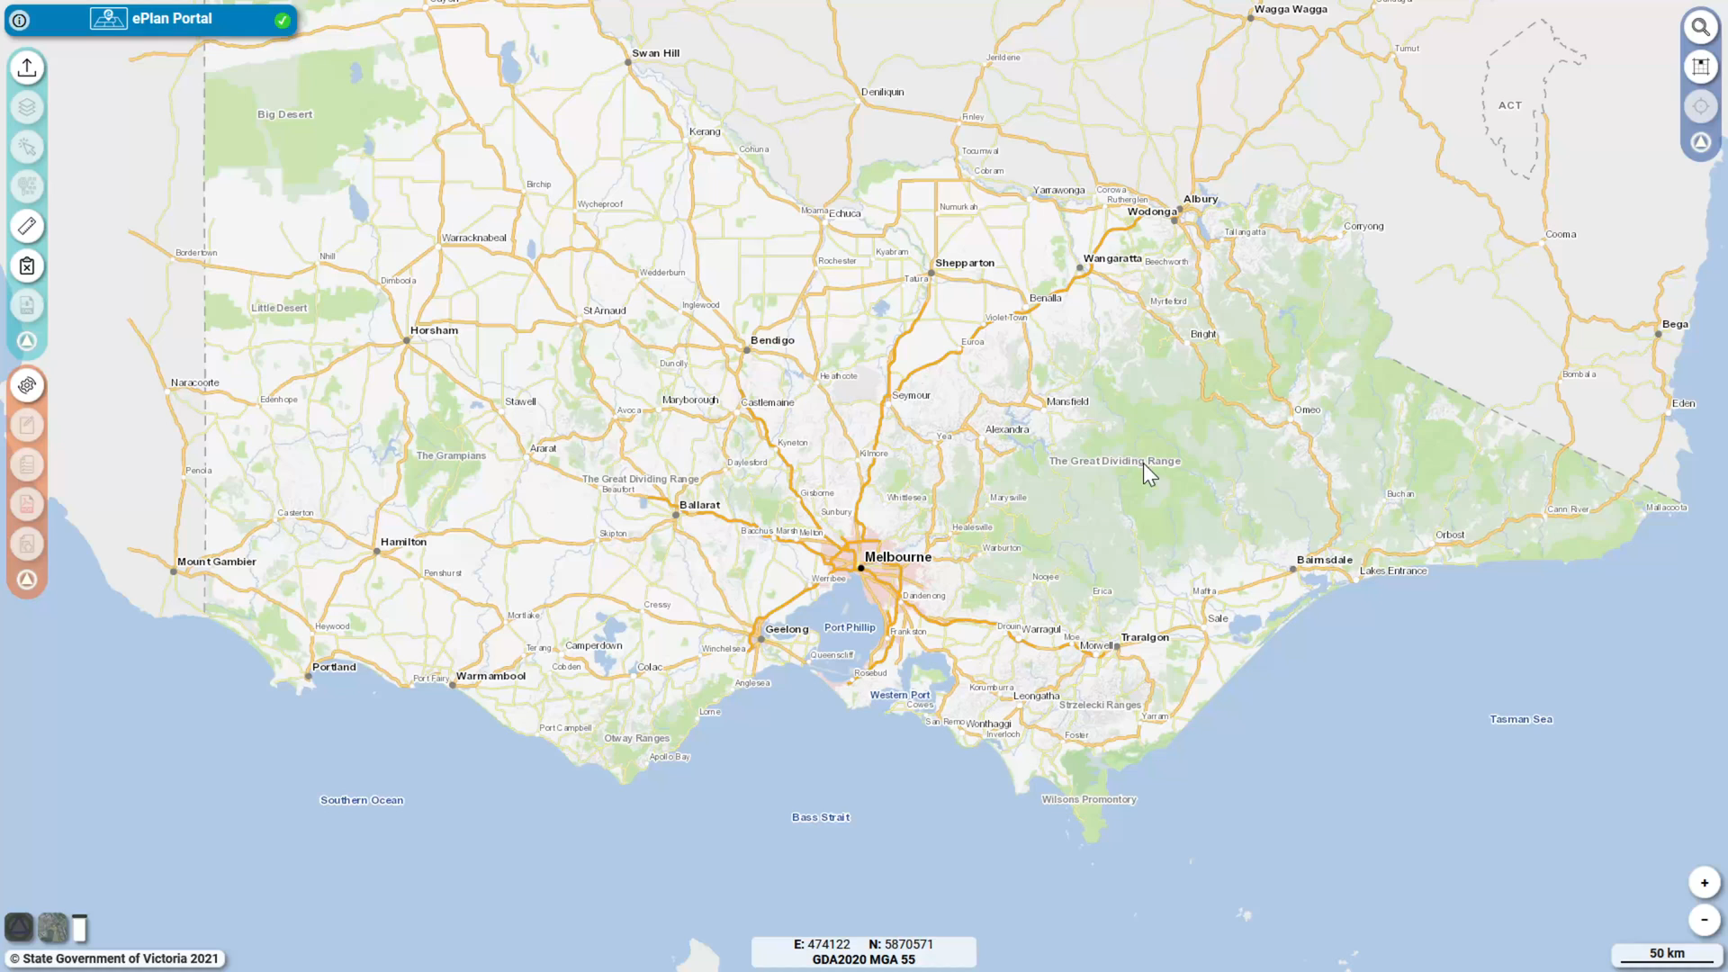






Data collated from:
SCFF
Victorian Online Titles System

Slide 47





ePlan Creation Service
Simplifies the ePlan creation process
Utilises multiple data sources to prepopulate metadata elements of the plan
Leads to streamlining the plan examination and registration process for Land Use Victoria
Provides a cadastral plan data source for the Digital Cadastre to support ongoing updates and maintenance

Slide 48
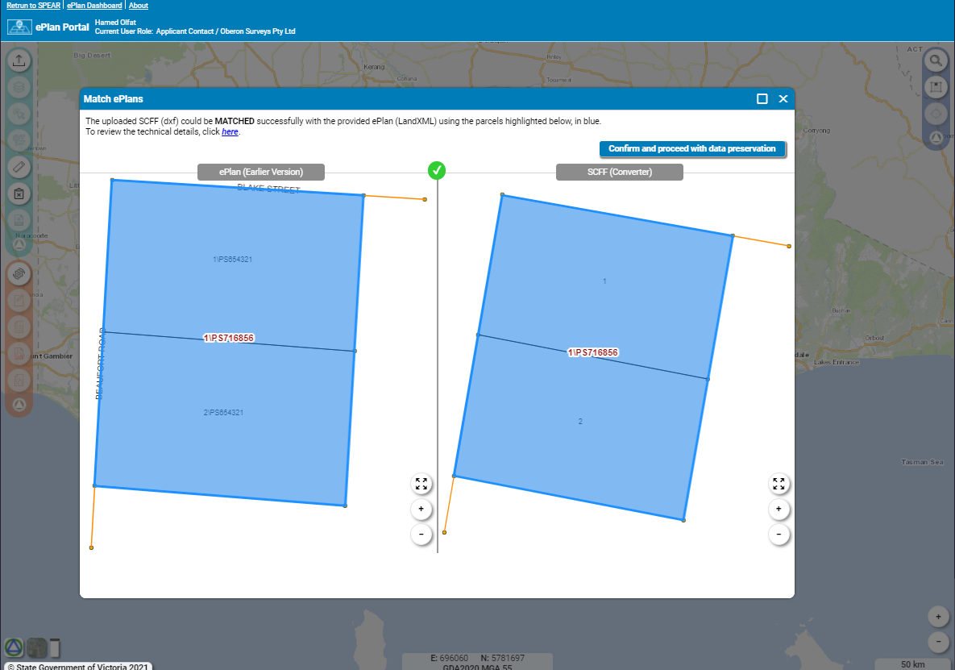
ePlan Portal
Data Viewer
ePlan Creation Service
ePlan Editor
ePlan Validator
ePlan Visualisation
Visualisation Enhancement Tool
Notes:
Easy to use platform for uploading your SCFF or ePlan LandXML file and accessing all the ePlan services.
Data Viewer – for viewing all the ePlan data visually & additional examination tools
ePlan Creation Service – the first step in creating a LandXML file from your valid SCFF
ePlan Editor – for entering the remaining required data to create the completed ePlan, or editing existing ePlan data
ePlan Validator – checking the ePlan file for any detectable errors
ePlan Visualiser – viewing a PDF version of the visualised plan
Visualisation Enhancement Tool – enhancing the look of the visualised plan by moving/rotating labels, creating enlargements, etc
An additional advantage to the ePlan Portal is that some functions are now interoperable, they compliment each other by working in tandem.
For example, the ePlan Validation report might give you an error regarding a specific survey point. A button on that error can be used to jump you directly to the feature within the data viewer so you can easily visually identify the feature that has the issue.
We’re also looking at similar synergy between the Validation report and ePlan editor, so not only will you be able to see visually where the problematic feature is, but also where in the ePlan editor that issue can be resolved to save you searching manually.
The ePlan portal, alongside the suite of ePlan services & introduction of the ePlan creation service makes getting involved with ePlan easier than ever & we encourage all surveying organisations who’ve put it off previously to give it a try when it becomes available – which is currently scheduled for our next SPEAR release towards the end of this year.

Slide 49
Service Desk Update
User Group Meeting
15 July 2021

Slide 50
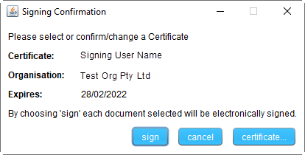
Do you digitally sign documents / decisions in SPEAR?
Signing application
Licensed Surveyor
Delegated Responsible Authority user
Legal practitioner
Licensed Surveyor at Land Use Victoria

Slide 51
Signing application
ALL signing users including those that have their certificates installed on a token, will be required to update their SPEAR Signing Application
Users must arrange installation of the new version of the Signing Application between its release in October 2021 and the cut over date in January 2022
It is recommended that users update as soon as possible from October 2021 to ensure they can sign ahead of January 2022
Notes:
Update early to avoid unwanted surprises in January

Slide 52
Please be prepared for this change:
Signing application
The exact dates and process for updating will be made widely available to SPEAR users in anticipation of this change
  Software installation permissions may be required
  Consider all computers that you currently sign from (home and office), as they will ALL need to be updated
After January 2022, any
users attempting to sign using the older version of the Signing Application will be presented with a message to download and install the new version before being able to proceed with signing

Slide 53

Release 5.3 Issues to be resolved
Lodging party access requests not able to be accepted
Applications not being updated to a status of ‘Registered’
Outstanding referral authority actions not visible to other organisations within a SPEAR application
Application Lodgement Forms created prior to the release (5 July) are returning system errors to lodging party users
Email / Download documents action is returning system errors to some users

Slide 54
Release 5.3 Issues and workarounds
SPEAR is non-responsive to certain actions
This is occurring intermittently, for example: clicking on something and receiving no response
Appears to be a browser caching issue
Clear the browser cache (using browser settings/options), or use a different browser (Chrome, Firefox and Microsoft Edge are our supported browsers)

Slide 55
Update: Greater Western Water
From 1 July 2021, City West Water and Western Water integrated to become Greater Western Water
The two Referral Authorities are now shown in SPEAR as:
Greater Western Water (formerly City West Water)
Greater Western Water (formerly Western Water)
All users will now see this updated in their SPEAR applications and referral lists.

Slide 56
Update: Greater Western Water
Also effective from 1 July 2021 City West Water Corporation have been appointed to take over the functions, powers, and duties of Western Region Water Corporation under the Water Act 1989
As such:
Easements and reserves for Western Region Water Corporation must now be created in favour of City West Water Corporation in accordance with the Water Act 1989
Any plan lodged with LUV referencing Western Region Water Corporation will be requisitioned for amendment by LUV before it can be registered
If you have any questions regarding this advice, please email the Subdivision Branch, Land Use Victoria subdivision.branch@delwp.vic.gov.au

Slide 57
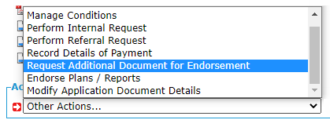
Handy hints: Request additional documents for endorsement
Responsible Authorities can use the optional action ‘Request Additional Document for Endorsement’ to request a new version of the Plan for Endorsement to be supplied by the Applicant Contact
This optional action is available even if the Permit Decision has been made and plans already endorsed

Slide 58
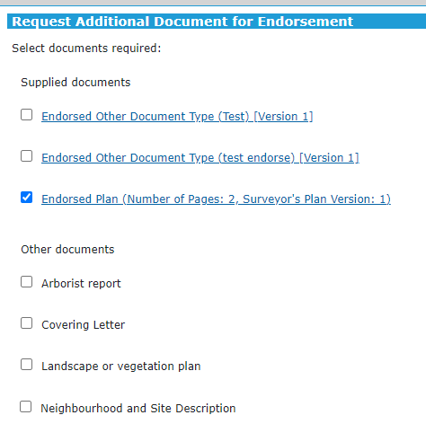
Handy hints: Request additional documents for endorsement
SPEAR will prompt the Responsible Authority user to select the required documents:
Previously endorsed documents will be shown at the top of the list
Other documents able to be endorsed shown below

Slide 59

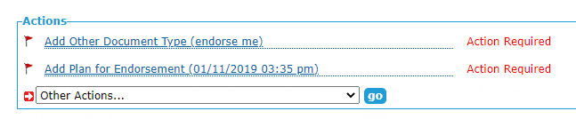
Handy hints: Request additional documents for endorsement
Once the user makes the required selection, they will be prompted to supply a reason (text or PDF) and then authenticate the action
A mandatory action will appear for the surveyor to supply
the requested document(s)

Slide 60

Handy hints: Personalise/Configure Application List
Customise the Application List to suit your personal preferences by:
Click and drag a column to change its location in the table
Change the width of columns by dragging the column borders in and out
Add or remove data in the list by using the settings icon to configure the columns
Remember to save changes by clicking the ‘save’ icon
Restore to the default view by clicking the ‘trash can’ icon
Download data from your list using the ‘data export’ icon

Slide 61
LASSI
GDA2020
LASSI release 2.19 - scheduled for November 2021, will update the base map datum from GDA94 to GDA2020 for all LASSI applications:
    LASSI
    LASSI-SPEAR
    SMES
    VICNAMES

Slide 62
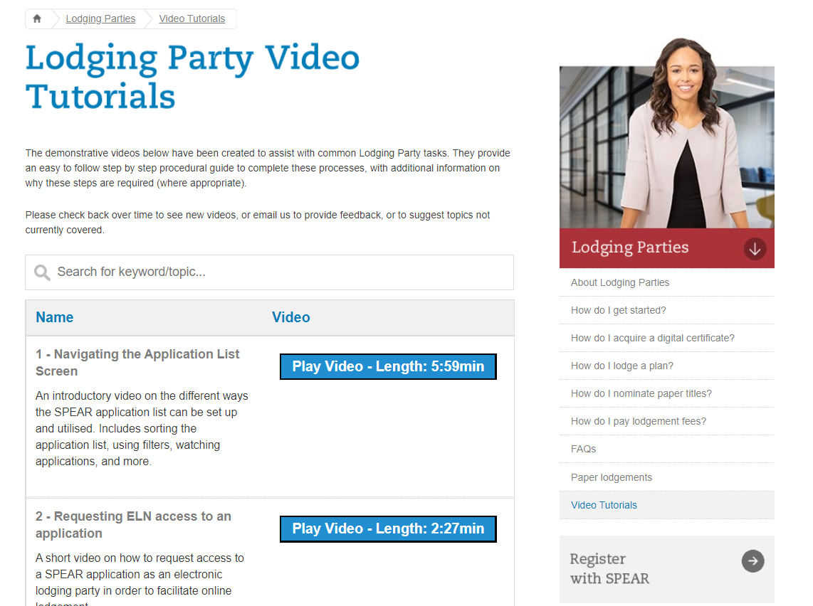
Training and support update
Training material - Videos
Video tutorials are available for lodging party users from the home page. These short videos provide a step-by-step guide for typical actions in SPEAR
Additional videos for other SPEAR users are being prepared

Slide 63
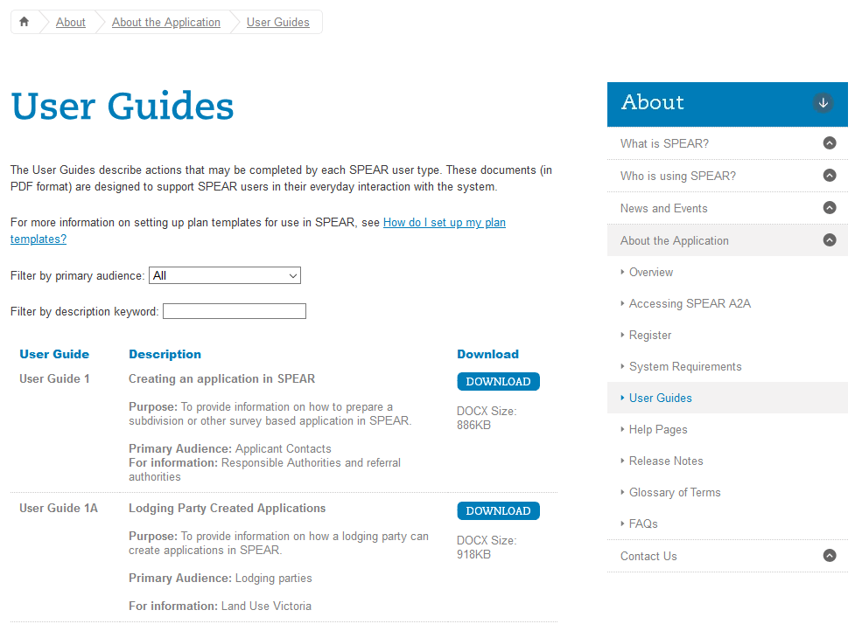
Training and support update
Training and support documents
Following an accessibility review by DELWP, all documents on the SPEAR website, including User Guides, FAQ’s, Release Notes and other attachments are being converted from .pdf to .docx format
Please review any bookmarks for documents on the SPEAR home page

Slide 64
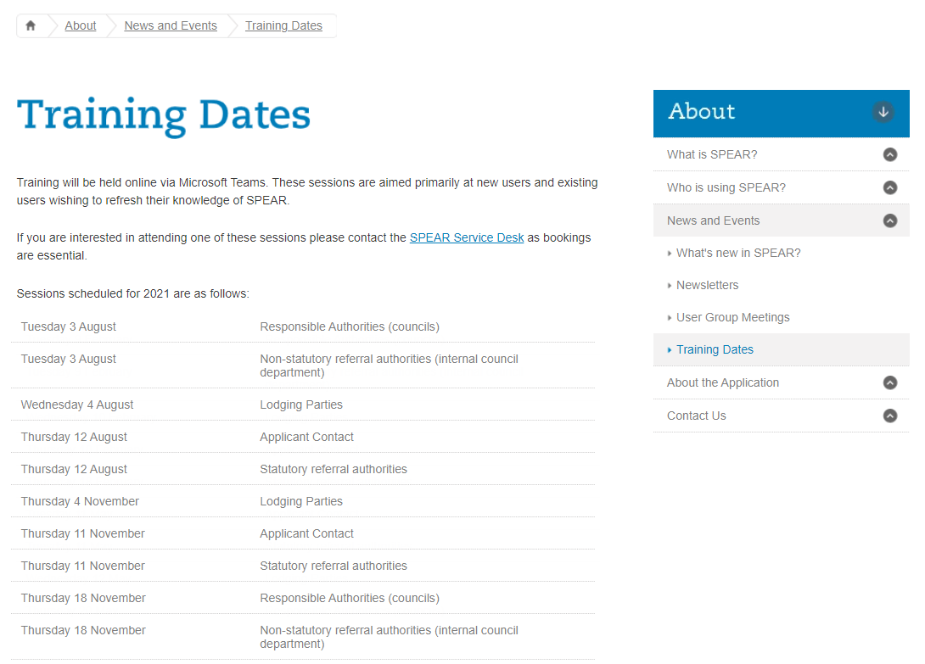
Training and support update
Training dates
Training dates for August and November are available from the SPEAR home page
All training is now performed online, using Microsoft Teams

Slide 65
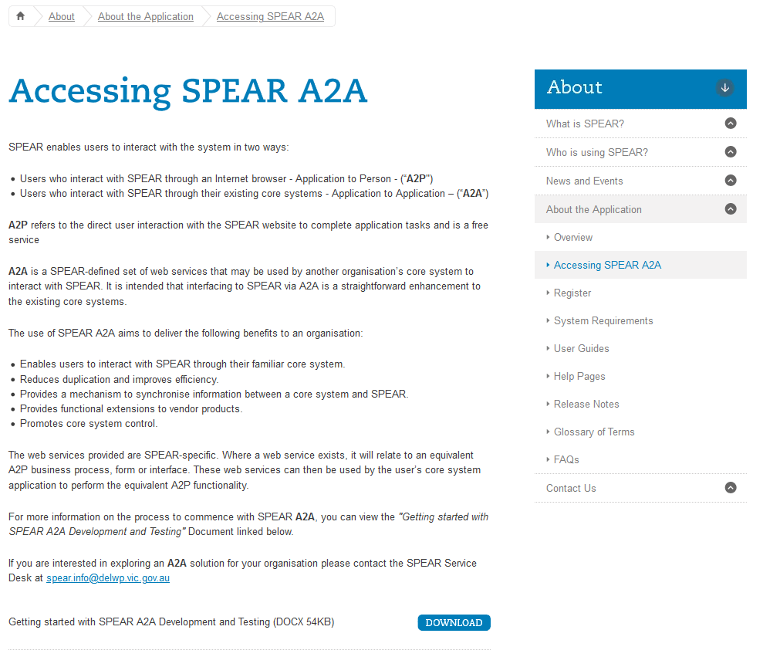
Training and support update
A2A support
The SPEAR Service Desk provides first level support for all SPEAR A2A users
Web services are available for the following user groups:
- Responsible Authority
- Applicant Contact
- Referral authority

Slide 66
Training and support update
Upcoming changes to phone support
LUV is in the process of modernising the application used for phone queuing systems.
The following changes are likely to affect SPEAR:
Changes to the menu options when calling the SPEAR Service Desk
Introduction of hold music when on hold or in the SPEAR queue
Potentially a new phone number for the SPEAR Service Desk

Slide 67
User Group Meeting
15 July 2021
Other matters

Slide 68
Subdivision (Registrars Requirements) Regulations 2011
Regulations are due to sunset in October 2021
Currently under review by LUV
Proposed to extend existing Regulations by 12 months
Surveying industry will be consulted shortly

Slide 69
Owners Corporation Additional Information​
Issues with current approach​:
Incorrect OCAI forms (OC1 and OC2) have become the most common reason for lodgment refusal​
OCAI forms are Instruments and cannot be requisitioned if errors are uncovered during examination, which can lead to delays in registration​

Slide 70
Owners Corporation Additional Information​
Proposed approach​:
Lodging party to no longer supply OC1 and OC2 forms​
Surveyor to continue to provide OC Details information in SPEAR / OC Schedule​
New ability for surveyor to amend textual OC Details at any stage until the plan is lodged at LUV​
New ability for LUV to requisition OC Details if changes are required during examination​
OC Details textual information will be imaged with the PS instrument

Slide 71
Owners Corporation Additional Information​
Benefits:
Reduced delays of lodgment by eliminating refusals for incorrect OC Details​
Time savings during examination due to ability to requisition OC Details (no more withdrawal and re-lodge to fix OCAIs)​
Streamlined OC Details screen will reduce duplication and potential conflict of data between surveyor and lodging party​
Minimal impact on surveying industry as surveyors already provide this information in SPEAR

Slide 72
Questions?
FPET Registration – https://tinyurl.com/SPEARFPET

